Slide 1

Artificial Intelligence Software For Diagnosis Of Cardiovascular
Diseases
Computer Science Department
Faculty Of Computer And Information Sciences
Ain Shams University

Slide 2

Team Members:
Alaa Ahmed
Sulieman Snossy
Karim Ali
Aya Hesham
Amira Ayman
Supervised By:
DR. Basant ElBagoury
TA. Lamis Hasan

Slide 3
Agenda
Introduction
Problem Definition
Objective
Related Work
Applications
Project Pipeline
Techniques
Time Plan
Dataset
Software Tools
References

Slide 4
Introduction

Slide 5

Introduction
heart problems have a significant influence on those who suffer from them, there have always been researches and continuous trials to improve health specifically in this area.
It has always been a great issue throughout history. The statistics show how essential CVDs are in healthcare.

Slide 6
Problem Definition

Slide 7
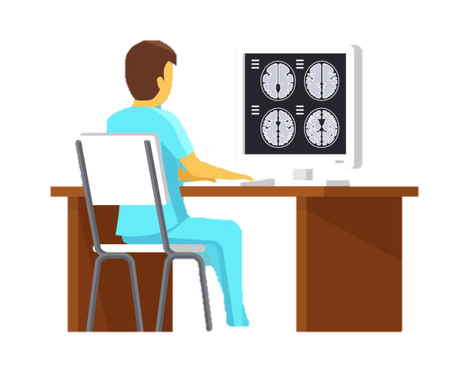
Problem Definition
Severe cardiovascular diseases can rapidly lead to death. At present, most studies in the deep learning field using electrocardiogram (ECG) are performed on intra-patient experi0ments for the classification of coronary artery disease (CAD), myocardial infarction, and congestive heart failure (CHF).

Slide 8
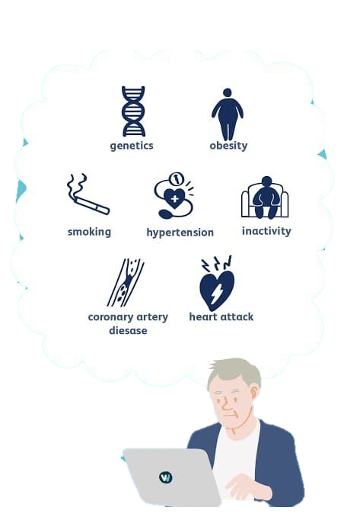
Problem Definition
Our project is mainly about diagnosing four of the CVDs , which are coronary artery disease (CAD), angina pectoris, myocardial infarction (MI), CHF and Normal Class.

Slide 9
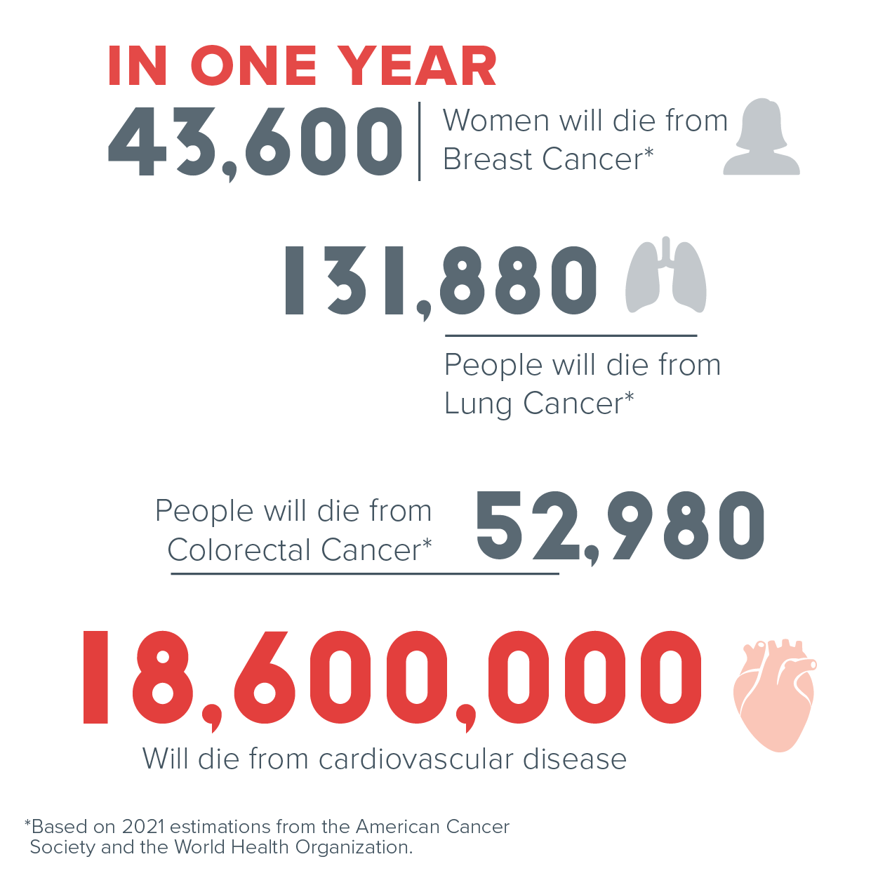
Why Cardiovascular ?
Nearly 20 million people are dying with heart-related problems every year across the globe.
It was estimated that the numbers would increase by 75 million by the end of 2040.

Slide 10

Why ECG?
An electrocardiogram records the electrical signals in the heart.
An electrocardiogram is a painless, noninvasive way to help diagnose many common heart problems.

Slide 11
Objective

Slide 12


Objective
Building model for early Diagnose the Cardiovascular Diseases for Patients based on their first hours.
Increase Models accuracy compared to existing models.
solving or avoiding the challenges and difficulties that face the existing Models.
Decrease the workload on Radiologists.
Support clinical decision making.
Minimizing The Human Error.

Slide 13
Related Work

Slide 14
Related Work
Name | Year | Methods | Dataset | Accuracy | Disadvantages
Heart Sounds Analysis and Classification for Cardiovascular Diseases Diagnosis using Deep Learning | 2022 | CNN such as ResNet KNN SVM Frequency Domain Adaptive Line Enhancer | Collected From General Public And From Clinical and hospitals CSV And Audio Files | 100% in Rouge | Not Good With Real Time Systems
Deep convolutional neural network for the automated diagnosis of congestive heart failure using ECG signals | 2018 | 11-layer deep CNN model | BIDMC Congestive Heart Failure Database | 99.85% for diagnostic | • Requires big data to achieve the optimum performance. • Requires extensive computational power for training the model.
An End-to-End Multi-Level Wavelet Convolutional Neural Networks for heart diseases diagnosis | 2020 | 1D-CNN ML-WCNN. | MIT-BIH Arrhythmia Database P-Wave Annotations | 99:57% | • long training time and computationally expensive. • long time in evaluation

Slide 15
Related Work
Name | Year | Methods | Dataset | Accuracy | Disadvantages
Prediction of Heart Disease Using Deep Convolutional Neural Networks | 2021 | CNN | dataset taken from the UCI repository | 97% | The processing of big data is an exhaustive task. challenges during data loading, storing, and processing.
Cardiac Disorder Classification by Electrocardiogram Sensing Using Deep Neural Network | 2021 | Single shoot detection (SSD) MobileNet v2 | ECG Images dataset of Cardiac Patients 4 Classes (N,MI,AH,History of MI) | 98% | ECG images are higher than the 800 KB in size, requiring lots of time to train the algorithm. Data resource identification
Residual Convolutional Neural Network for Cardiac Image Segmentation and Heart Disease Diagnosis | 2020 | • RCNN(Bi-CLSTM+RCNN) | ACDC (Automated cardiac diagnosis challenge) | 94% | Low Accuracy Against to others

Slide 16
Applications

Slide 17
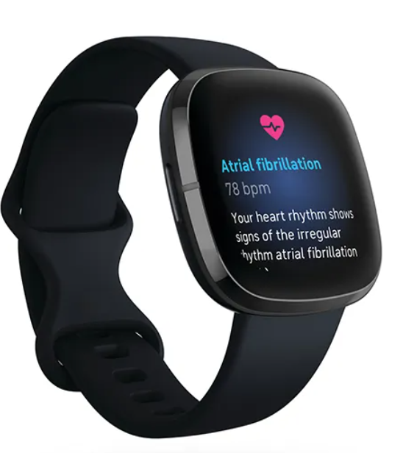
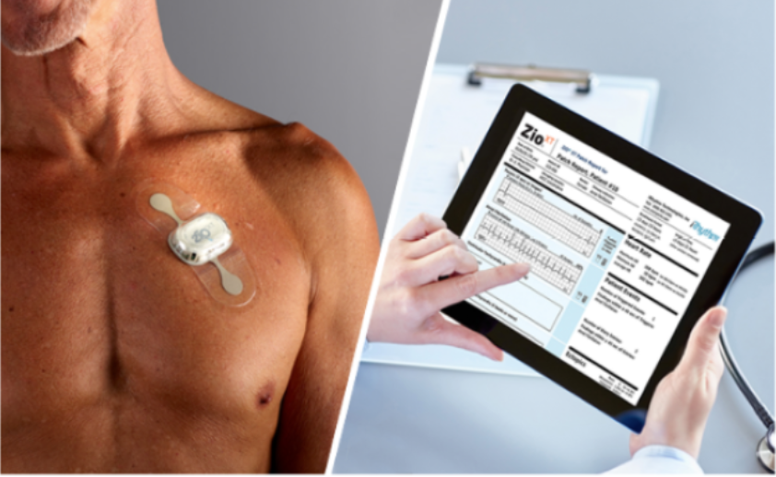
Applications
Apple Heart Study Adhesive wireless smart patches
Fitbit Sense

Slide 18
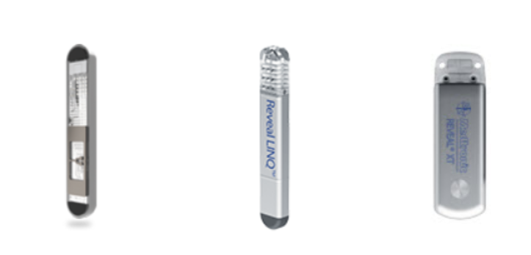
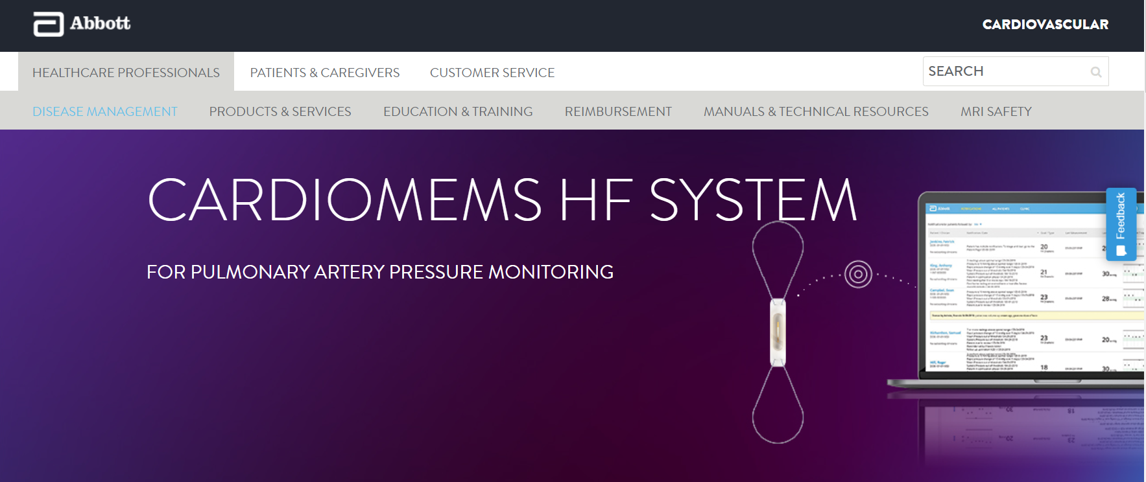
Applications(cont.)
Insertable cardiac monitorsCardioMEMS HF System – Abbott

Slide 19
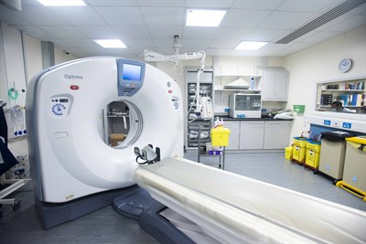
Applications(cont.)
Cardiac Computerized Tomography (CT) Imaging

Slide 20
Project Pipeline

Slide 21
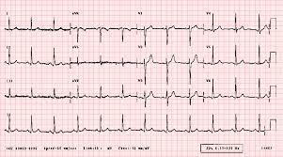
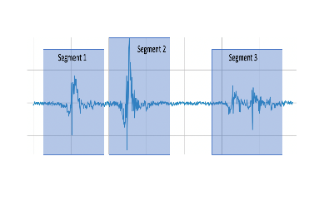

Project Pipeline
Dataset Collection : ECG Data
Understanding Domain Data
ECG Data Preprocessing
Segmentation
Obtain Results(Accuracy, Precision, Recall)
Training Deep Learning Multi-Classifier Model
Removing Noises
ECG Feature Extraction
User Interface Layer
Compare & Predict
User Interface Development & System Integration
Predicted Output
Mobile Application

Slide 22
Techniques

Slide 23
Techniques
Feature Extraction
Classification
Model Evaluation
CResnet feature
Transformer feature
CNN
Resnet
Encoder
Softmax
10-fold cross-validation
Feed forward
Output
Convolution
Layer
Pooling
Layer
normal
CAD
MI
CHF

Slide 24
Time Plan

Slide 25
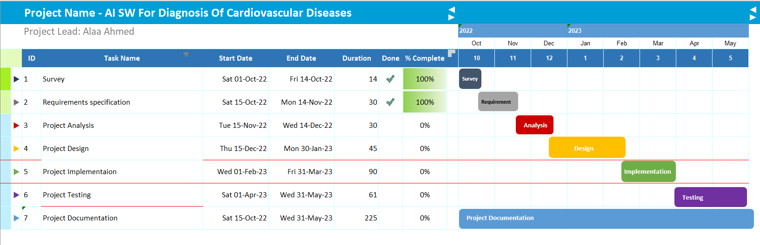
Time Plan

Slide 26
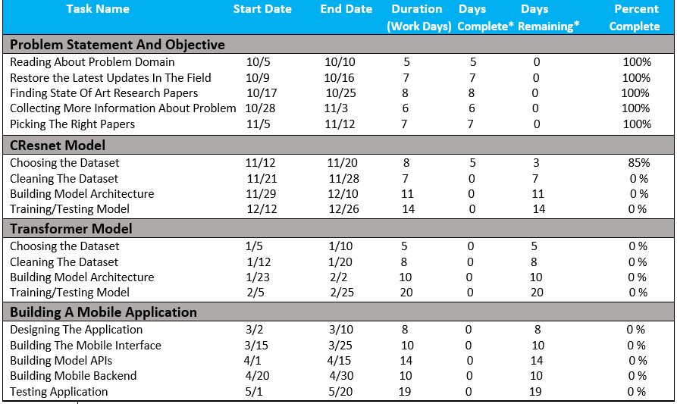
Time Plan

Slide 27
Dataset

Slide 28
Dataset
The ECG signal data used in this study were obtained from a public database (PhysioBank).
four public databases of ECGs on normal, CAD, MI, and CHF

Slide 29
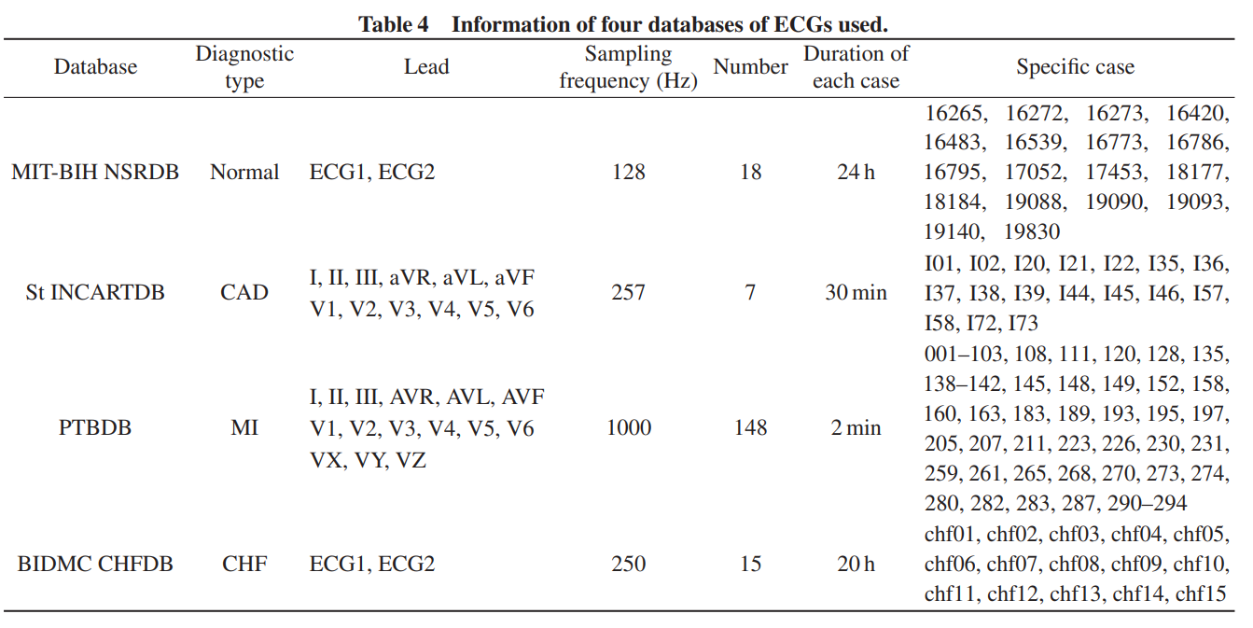
Data Set

Slide 30
Software Tools

Slide 31



Software Tools
Flutter Framework
for Mobile Application
TensorFlow
API for Deep Learning Models
Python Language

Slide 32


Software Tools – (cont.)
An integrated development environment used in programming language
(GPU)
An integrated development environment

Slide 33
References
[1] Mhamdi; Dammak; Cottin; Dhaou, I.B. Artificial Intelligence for Cardiac Diseases Diagnosis and Prediction Using ECG Images on Embedded Systems. Biomedicines 2022, 10, 2013 ; Published: 19 August 2022. https://doi.org/10.3390/biomedicines10082013
[2] Furqan Rustam;Abid Ishaq;Kashif Munir;Mubarak Almutairi;Naila Aslam and Imran Ashraf .Diagnostics 2022;15 Jun 2022,12(6), 1474.Incorporating CNN Features for Optimizing Performance of Ensemble Classifier for Cardiovascular Disease Prediction.
[3] Chen-Chi Chang;I-Jung Tsai;Wen-Chi Shen;Hung-Yi Chen;Po-Wen Hsu and Ching-Yu Lin .Diagnostics 2022;08 Jun 2022, 12(6), 1415. A Coronary Artery Disease Monitoring Model Built from Clinical Data and Alpha-1-Antichymotrypsin . https://doi.org/10.3390/diagnostics12061415
[4] Carlos Martin-Isla; Victor M. Campello; Cristian Izquierdo; Zahra Raisi-Estabragh; Bettina Baeßler; Steffen . Petersen and Karim Lekadir . 24 January 2020 . Image-Based Cardiac Diagnosis With Machine Learning . https://www.frontiersin.org/articles/10.3389/fcvm.2020.00001/full
[5] MAlnajjar, M. K., & Abu-Naser, S. S. (2022). Heart Sounds Analysis and Classification for Cardiovascular Diseases Diagnosis using Deep Learning.
[6] Khan, A. H., Hussain, M., & Malik, M. K. (2021). Cardiac disorder classification by electrocardiogram sensing using deep neural network. Complexity, 2021.
[7] Khalil, M., & Adib, A. (2020). An end-to-end multi-level wavelet convolutional neural networks for heart diseases diagnosis. Neurocomputing, 417, 187-201.
[8] Mehmood, A., Iqbal, M., Mehmood, Z., Irtaza, A., Nawaz, M., Nazir, T., & Masood, M. (2021). Prediction of heart disease using deep convolutional neural networks. Arabian Journal for Science and Engineering, 46(4), 3409-3422.

Slide 34
Questions?

Slide 35
Thanks!

